Slide 1
CODING FELLAS
TEAM MEMBERS
JYOTIRMAY NAYAK
MITHILESH MISHRA ROHIT JAISWAL PRAYASH MOHAPATRA
"AN IDEA TO HARNESS RENEWABLE RESOURCE"

Slide 2

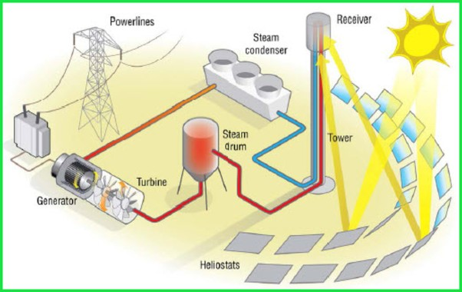
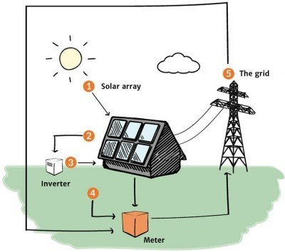
IDEATION
There will be 3 main components of the entire build - A solar cell, a wind turbine connected with it and a water tank to heat up the water and also a salt water generator.
The solar cell and mobile wind turbine will generate respective energy from the wind and sun rays
The solar cell will be angled in such a way that it will focus the sun rays to heat the molten salt which will heat up the salt and in turn, it will heat the water to make steam which will rotate the turbines and ultimately generate electricity .

Slide 3
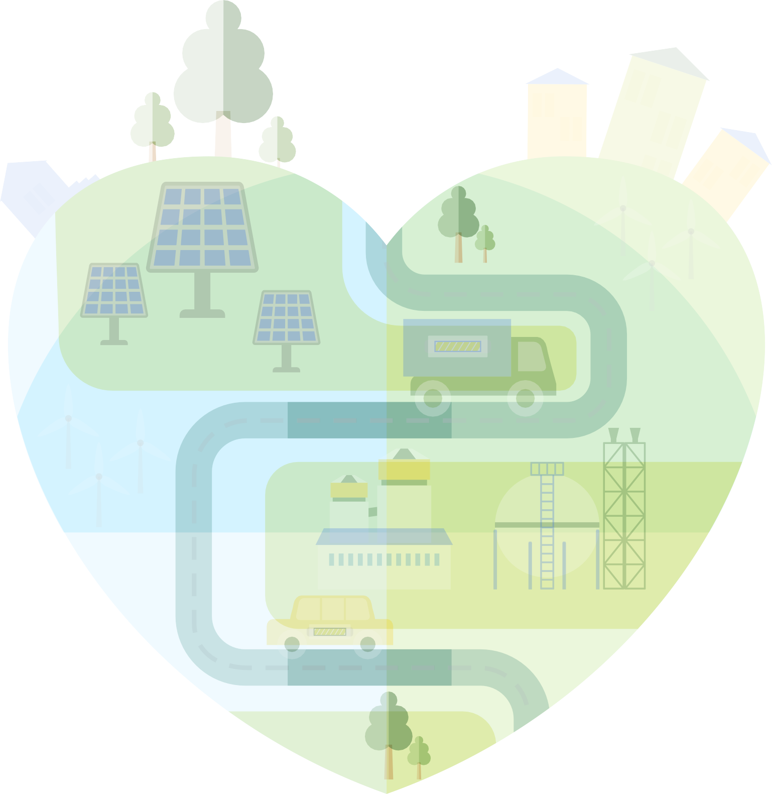
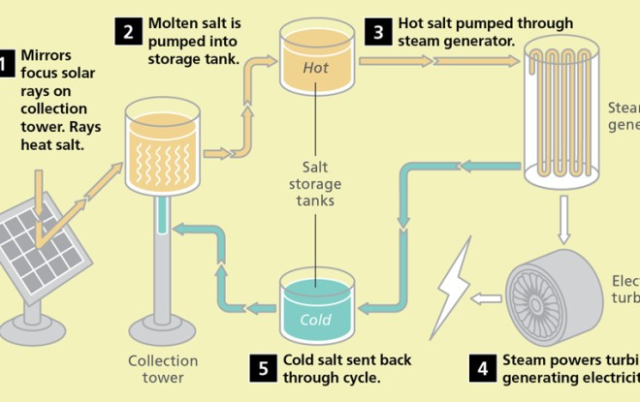
An Efficient Molten Salt + Solar and
vertical axis wind turbine
WORKING
When demand is low, mirrors reflect sunlight onto tanks of
molten salt, heating them almost to 1,000 F. When demand is high, the salt’s heat turns water into steam to drive a turbine, making electricity.
Molten Salt Storage

Slide 4
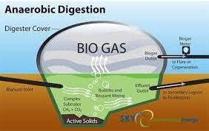
BIO-GAS IMPLEMENTATION
The organic waste accumulated is this chamber and stored for decomposition , an extra tank is there which will be stored underground
For bio-gas as a resevoir. The bio gas will then be used in parallel to make steam and it can also be supplied as kitchen fuel in every house
Pro- low cost installation , high yield cost - needs space , time is required for
decomposition

Slide 5
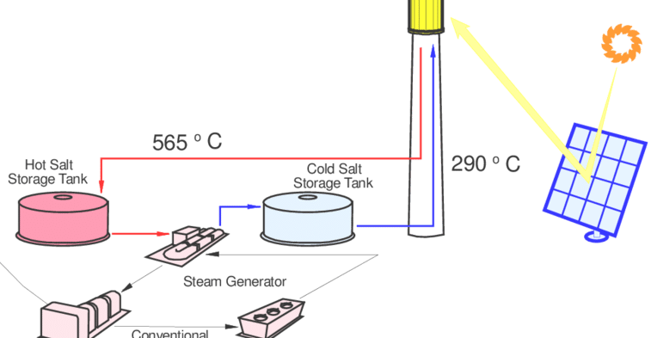
CONCLUSION:
The energy generated from the turbines (Steam energy),
Solar,Wind and Bio-Mass are collectively USED FOR THE NEEDFUL.

